Slide 1
Discrete Mathematics

Slide 2
Textbook: Discrete and Combinatorial Mathematics:
An Applied Introduction 3rd edition,
by Ralph P. Grimaldi
Course Outlines:
1. Fundamental Principles of Counting
2. Fundamentals of Logic
3. Set Theory
4. Mathematical Induction
5. Relations and Functions
6. Languages: Finite State Machines
7. The principle of Inclusion and Exclusion
8. Generating Functions
9. Recurrence Relations
10. Graph Theory
11. Boolean Algebra and Switching Functions

Slide 3
1. make you smarter
2. Solve interesting problems
The Berge Mystery: 6 men had been to the library on the day that
the rare book was stolen. If two were in the library at the same time,
then at least one of them saw the other. Detective Poirot
questioned the suspects and gathered the following testimony:
A saw B and E. F saw C and E
B saw A and F. E saw B and C. Now, who is the thief?
C saw D and E. D saw A and F.

Slide 4
Chapter 1: Fundamental Principles of Counting
1.1 The Rules of Sum and Product
problem decompose combine
The Rule of Sum
Task 1 Task 2
m ways n ways
can not be done simultaneously
then performing either task can be accomplished in any one of
m+n ways

Slide 5
Chapter 1: Fundamental Principles of Counting
1.1 The Rules of Sum and Product
E.g. 1.1: 40 textbooks on sociology
50 textbooks on anthropology
to select 1 book: 40+50 choices
What about selecting 2 books?

Slide 6
Chapter 1: Fundamental Principles of Counting
1.1 The Rules of Sum and Product
E.g. 1.2: things 1 2 3 ... k
ways m₁ m₂ m₃ m_{k}
select one of them: m₁ +m₂ +m₃ +...+ m_{k} ways

Slide 7
Chapter 1: Fundamental Principles of Counting
1.1 The Rules of Sum and Product
The Rule of Product
Task 1 Task 2
m ways n ways
then performing this task can be accomplished in any one of
mn ways

Slide 8
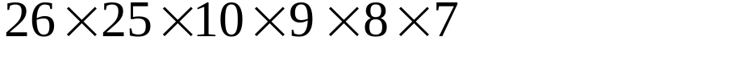
Chapter 1: Fundamental Principles of Counting
1.1 The Rules of Sum and Product
The Rule of Product
E.g. 1.6. The license plate: 2 letters-4 digits
(a) no letter or digit can be repeated
(b) with repetitions allowed
(c) same as (b), but only vowels and even digits
5²
x5⁴

Slide 9
Chapter 1: Fundamental Principles of Counting
1.1 The Rules of Sum and Product
BASIC variables: single letter
or single letter+single digit
26+26x10=286
rule of sum
rule of product

Slide 10
Chapter 1: Fundamental Principles of Counting
1.2 Permutations
E.g. 1.9. 10 Selecting 5 students from 10 to get a picture
Def 1.1 For an integer n≧0, n factorial (denoted n!) is defined by
0!=1,
n!=(n)(n-1)(n-2)...(3)(2)(1), for n≧1.
Beware how fast n! increases.
10!=3628800
2¹⁰=1024

Slide 11
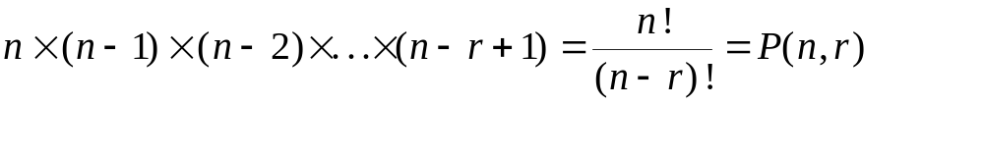
Chapter 1: Fundamental Principles of Counting
1.2 Permutations
Def 1.2 Given a collection of n distinct objects, any (linear)
arrangement of these objects is called a
permutation of the collection.
if repetitions are allowed: n^{r}

Slide 12
Chapter 1: Fundamental Principles of Counting
1.2 Permutations
E.g. 1.11 permutation of BALL 4!/2!=12
E.g. 1.12 permutation of PEPPER 6!/(3!2!)=60
E.g. 1.13 permutation of MASSASAUGA 10!/(4!3!)=25200
if all 4 A’s are together 7!/3!=840

Slide 13
Chapter 1: Fundamental Principles of Counting
1.2 Permutations
E.g. 1.14 Number of Manhattan paths between
two points with integer coordinated
From (2,1) to (7,4): 3 Ups, 5 Rights
Each permutation of UUURRRRR is a path.
8!/(5!3!)=56

Slide 14
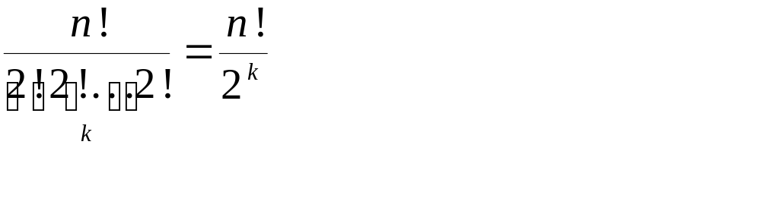
Chapter 1: Fundamental Principles of Counting
Combinatorial Proof
E.g. 1.15 Prove that if n and k are positive integers with n=2k,
then n!/2^{k} is an integer.
Consider the n symbols x₁,x₁,x₂,x₂,...,x_{k},x_{k}.
Their permutation is
must be an integer

Slide 15
Chapter 1: Fundamental Principles of Counting
circular permutation
E.g. 1.16 6 people are seated about a round table, how many
different circular arrangements are possible, if
arrangements are considered the same when one can
be obtained from the other by rotations?
ABCDEF,BCDEFA,CDEFAB,DEFABC,EFABCD,FABCDE
are the same arrangements circularly.
6!/6=5! (in general, n!/n)

Slide 16
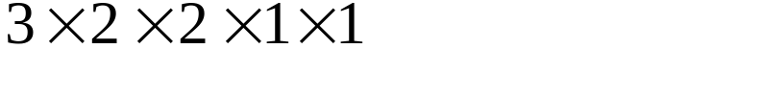
Chapter 1: Fundamental Principles of Counting
circular permutation
E.g. 1.17 3 couples in a round table with alternating sex
F
3 ways
1 way
M1
M3
total=
F2
2 ways
1 way
F3
M2
2 ways

Slide 17
Chapter 1: Fundamental Principles of Counting
Exercise 1.1 and 1.2 on page 12.
26, 30

Slide 18
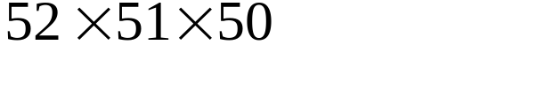
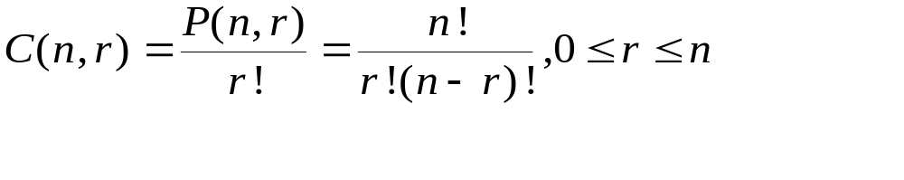
Chapter 1: Fundamental Principles of Counting
1.3 Combinations: The Binomial Theorem
Select 3 cards from a deck of playing cards without replacement:
order of selection is relevant: P(52,3)=
order of selection is irrelevant: P(52,3)/3!=C(52,3)

Slide 19
Chapter 1: Fundamental Principles of Counting
1.3 Combinations: The Binomial Theorem
When dealing with any counting problem, we should ask ourselves about the importance of order in the problem. When order is relevant, we think in terms of permutations and arrangements and the rule of product. When order is not relevant, combinations could play a key role in solving the problem.

Slide 20
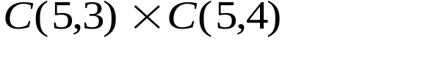
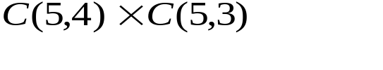
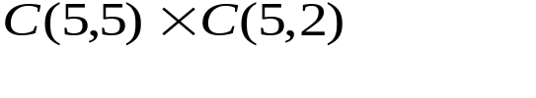
Chapter 1: Fundamental Principles of Counting
1.3 Combinations: The Binomial Theorem
E.g. 1.19 (a) Answering 7 questions from 10: C(10,7)
(b) 3 from first 5, 4 from the others:
(c) 7 from 10, At least 3 from first 5,
3 from 5 first:
4 from 5 first :
5 from 5 first :
50+50+10

Slide 21
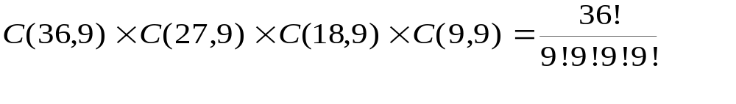
Chapter 1: Fundamental Principles of Counting
1.3 Combinations: The Binomial Theorem
E.g. 1.21 Four teams of nine girls each from the 36 girls.
method 1.
method 2. students 1 2 3 4 ... 36
teams ABCD ... B (9 As,9Bs,9Cs,9Ds)

Slide 22
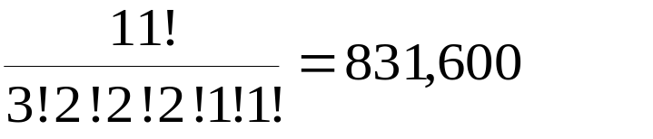
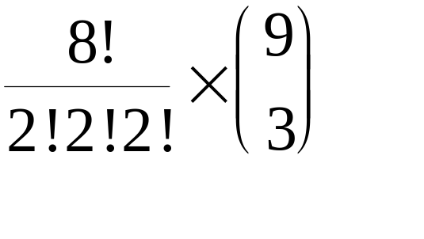
Chapter 1: Fundamental Principles of Counting
1.3 Combinations: The Binomial Theorem
E.g. 1.22 TALLAHASSEE permutation=
without adjacent A:
disregard A first
9 positions for 3 A
to be inserted
Challenge: Write a program to verify your answer.

Slide 23
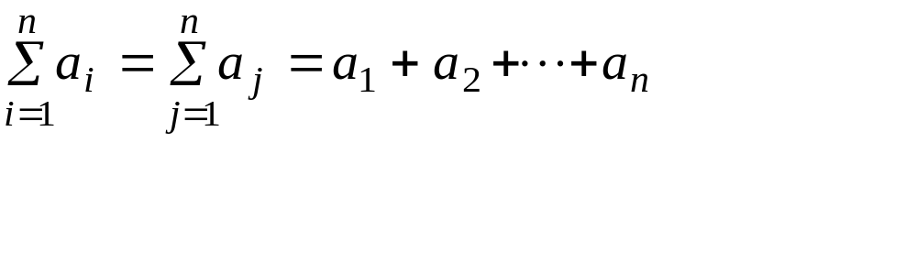
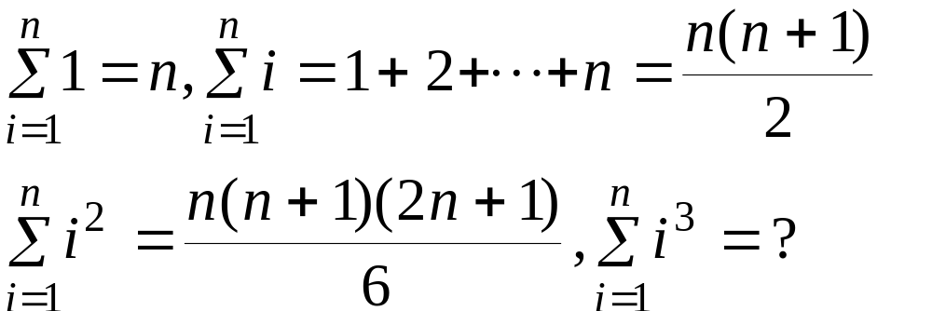
Chapter 1: Fundamental Principles of Counting
The Sigma notation
For example,
You will learn how to compute something like that later.

Slide 24
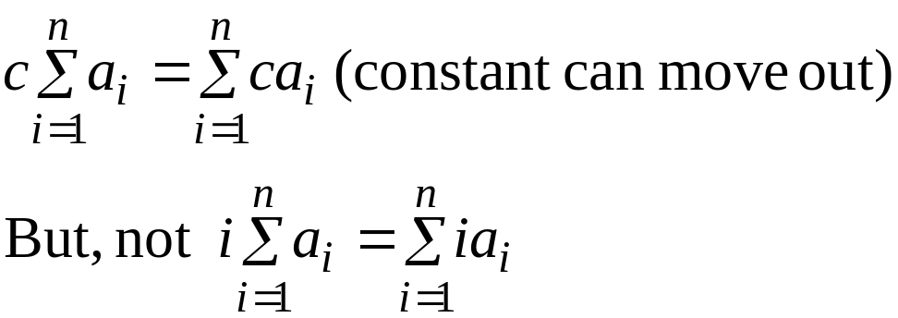
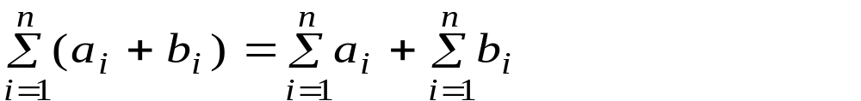
Chapter 1: Fundamental Principles of Counting
The Sigma notation

Slide 25
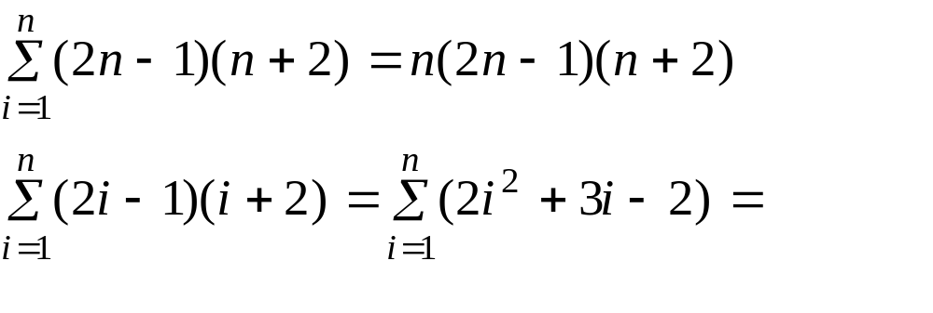
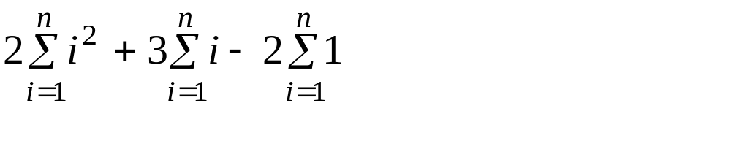
Chapter 1: Fundamental Principles of Counting
The Sigma notation
For example,

Slide 26
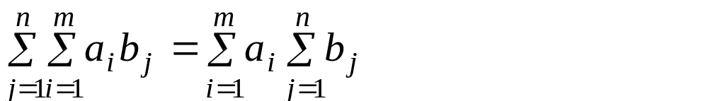
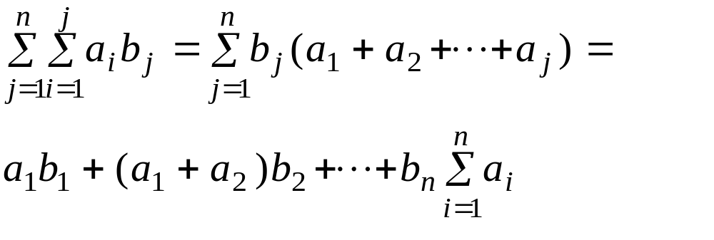
Chapter 1: Fundamental Principles of Counting
The Sigma notation

Slide 27
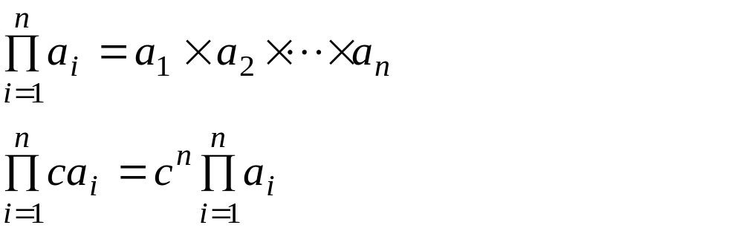
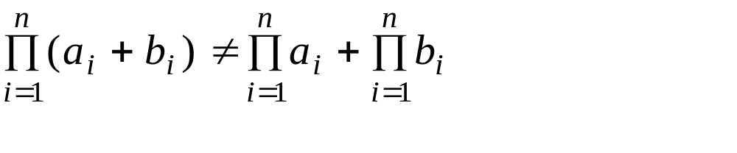
Chapter 1: Fundamental Principles of Counting
The Pi notation

Slide 28
Chapter 1: Fundamental Principles of Counting
1.3 Combinations: The Binomial Theorem
E.g. 1.23
alphabets: a,b,c,d,...,1,2,3,...
symbols: a,b,c,ab,cde,...
strings: concatenation of symbols, ababab,bcbdgfh,...
languages: set of strings
{0,1,00,01,10,11,000,001,010,011,100,101,...}
={all strings made up from 0 and 1}

Slide 29
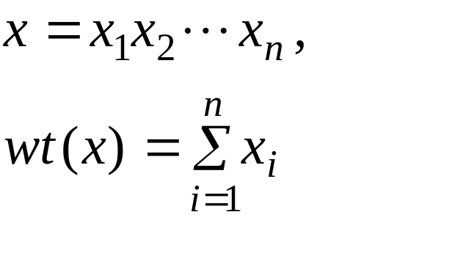
Chapter 1: Fundamental Principles of Counting
1.3 Combinations: The Binomial Theorem
E.g. 1.23
Using 0,1,2 the number of string with length n: 3^{n}
if
define
for example, wt(000)=0, wt(1200)=3

Slide 30
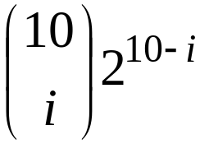
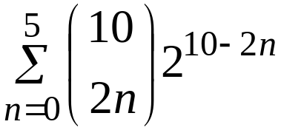
Chapter 1: Fundamental Principles of Counting
1.3 Combinations: The Binomial Theorem
E.g. 1.23
Among the 3¹⁰ strings of length 10, how many have
even weight?
Ans.: the number of 1’s must be even
number of 1’s=i (i=0,2,4,6,8, or 10)
number of strings=
Select i positions for the
i 1’s
total=

Slide 31
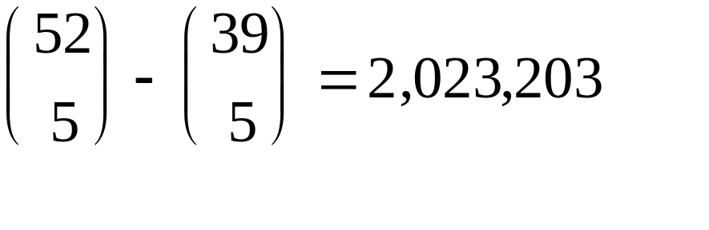
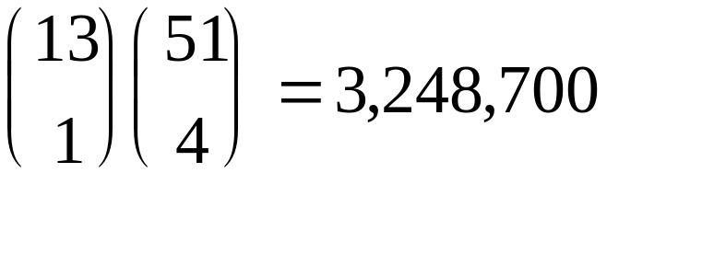
Chapter 1: Fundamental Principles of Counting
1.3 Combinations: The Binomial Theorem
Be careful not to overcount.
E.g. 1.24 Select 5 cards which have at least 1 club.
reasoning (a): all minus no-club
reasoning (b): select 1 club first, then other 4 cards
What went wrong?

Slide 32
Chapter 1: Fundamental Principles of Counting
1.3 Combinations: The Binomial Theorem
Be careful not to overcount.
E.g. 1.24 Select 5 cards which have at least 1 club.
for reasoning (b):
select C3 then C5,CK,H7,SJ
select C5 then C3,CK,H7,SJ
All are the same selections.
select CK then C5,C3,H7,SJ

Slide 33
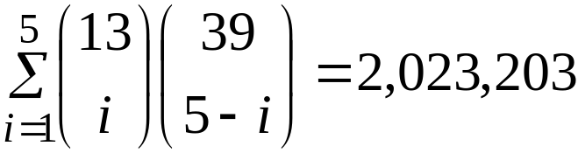
Chapter 1: Fundamental Principles of Counting
1.3 Combinations: The Binomial Theorem
Be careful not to overcount.
E.g. 1.24 Select 5 cards which have at least 1 club.
for reasoning (b):
correct computation
non-clubs
number of clubs selected

Slide 34
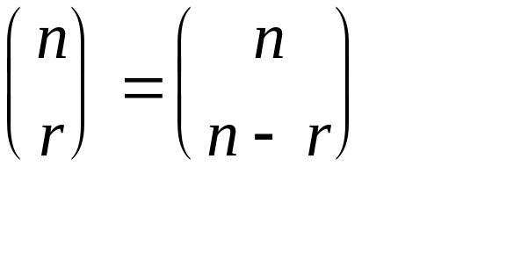
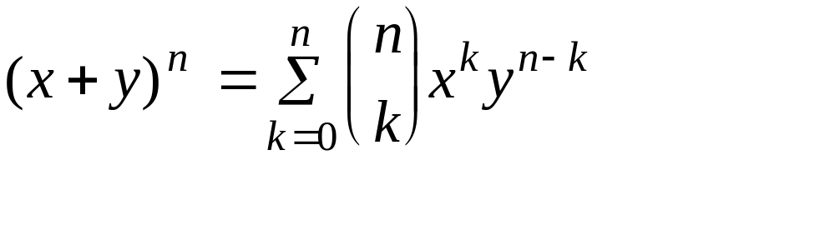
Chapter 1: Fundamental Principles of Counting
1.3 Combinations: The Binomial Theorem
Try to prove it by combinatorial reasoning.
Theorem 1.1 The Binomial Theorem
binomial coefficient
Select k x’s from (x+y)^{n}

Slide 35
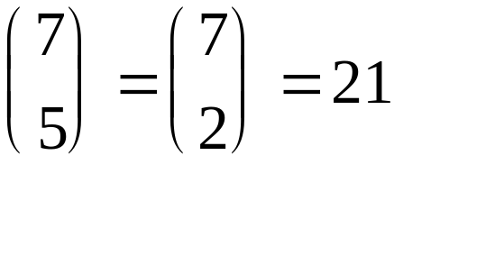
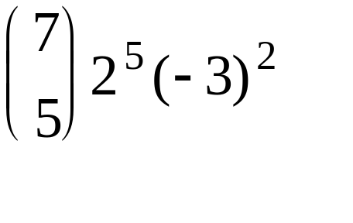
Chapter 1: Fundamental Principles of Counting
1.3 Combinations: The Binomial Theorem
E.g. 1.25 The coefficient of x⁵y² in (x+y)⁷ is
The coefficient of a⁵b² in (2a-3b)⁷ is

Slide 36
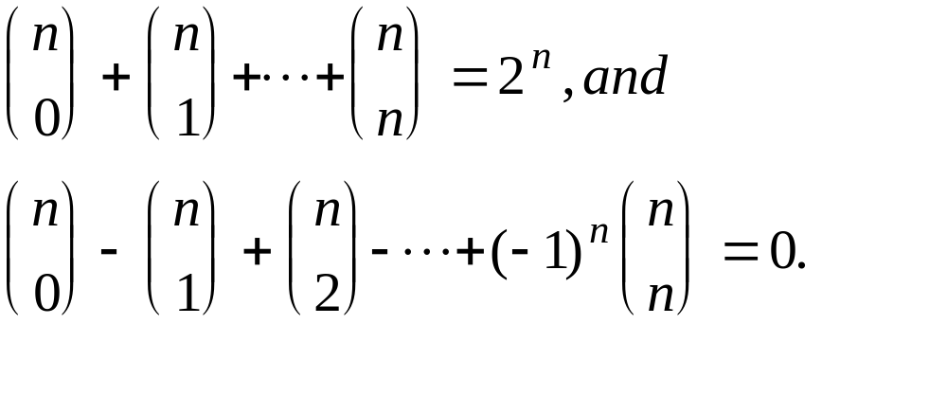
Chapter 1: Fundamental Principles of Counting
1.3 Combinations: The Binomial Theorem
Corollary 1.1. For any integer n>0,
(a)
(x=y=1)
(b)
(x=1,y=-1)

Slide 37
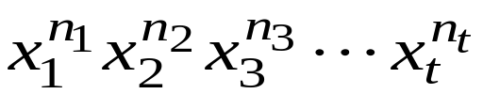
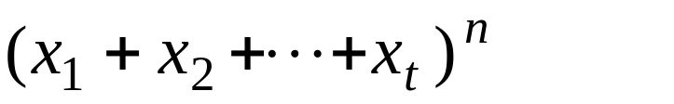
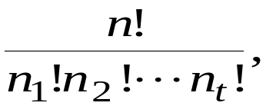
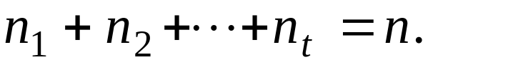
Chapter 1: Fundamental Principles of Counting
1.3 Combinations: The Binomial Theorem
Theorem 1.2 The multinomial theorem
For positive integer n,t, the coefficient of
in the expansion of
is
where

Slide 38
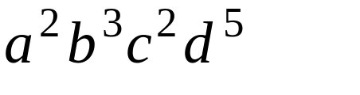
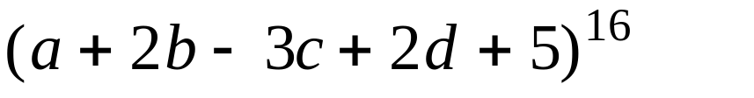
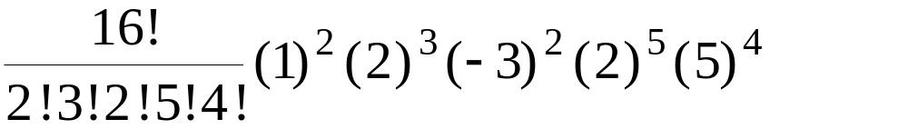
Chapter 1: Fundamental Principles of Counting
1.3 Combinations: The Binomial Theorem
E.g.. 1.26 The coefficient of
in
is

Slide 39
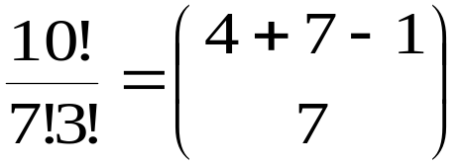
Chapter 1: Fundamental Principles of Counting
Exercise 1.3. 4, 22, 34
1.4 Combinations with Repetition: Distributions
E.g. 1.27 7個人買食物,有四種食物可選擇,有幾種買法?
first second third fourth
xxx
xxxx
xx
x
x
xxx
xxxx
xxx
for x
for

Slide 40
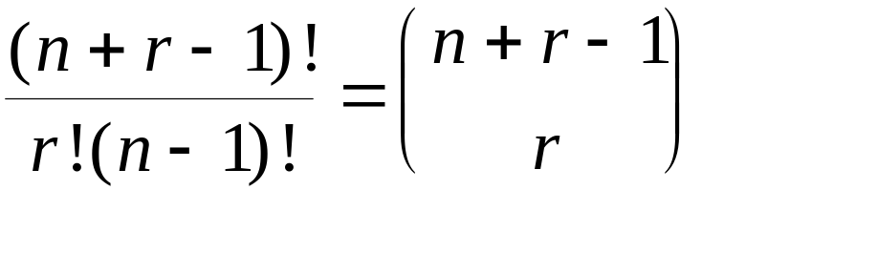
Chapter 1: Fundamental Principles of Counting
1.4 Combinations with Repetition: Distributions
In general, the number of selections, with repetitions, of r
objects from n distinct objects are:

Slide 41
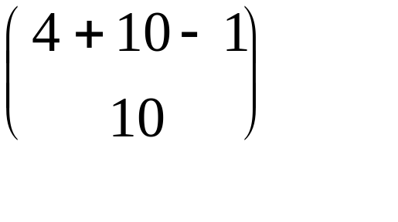
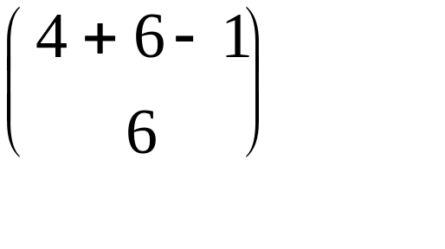
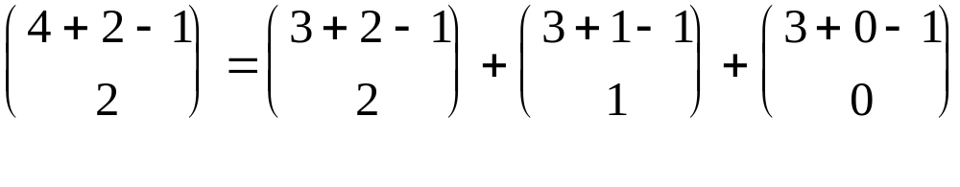
Chapter 1: Fundamental Principles of Counting
1.4 Combinations with Repetition: Distributions
E.g. 1.29 Distribute $1000 to 4 persons (in unit of $100)
(a) no restriction
(b) at least $100 for anyone
(c) at least $100 for anyone, Sam has at least $500

Slide 42
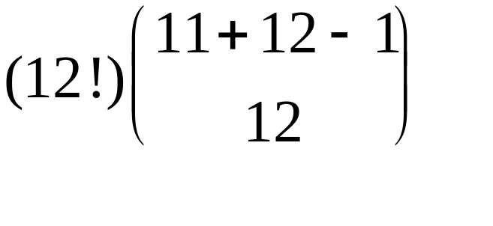
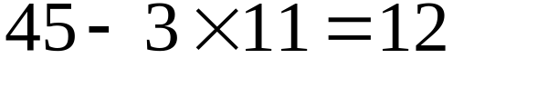
Chapter 1: Fundamental Principles of Counting
1.4 Combinations with Repetition: Distributions
E.g. 1.31
A message: 12 different symbols+45 blanks
Transmitted
through
network
at least 3 blanks between consecutive symbols
blanks
available positions

Slide 43
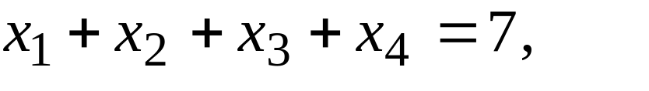
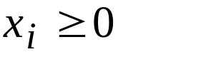
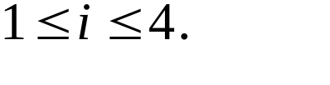



Chapter 1: Fundamental Principles of Counting
1.4 Combinations with Repetition: Distributions
E.g. 1.32 Determine all integer solutions to the equation
where
for all
select with repetition from
7 times
For example, if
is selected twice, then
in the final solution. Therefore, C(4+7-1,7)=120

Slide 44
Chapter 1: Fundamental Principles of Counting
1.4 Combinations with Repetition: Distributions
Equivalence of the following:
(a) the number of integer solutions of the equation
(b) the number of selections, with repetition, of size r from a collection
of size n
(c) the number of ways r identical objects can be distributed among
n distinct containers

Slide 45





Chapter 1: Fundamental Principles of Counting
1.4 Combinations with Repetition: Distributions
E.g. 1.34 How many nonnegative integer solutions are there to
the inequality
It is equivalent to
which can be transformed to
where
for
and
C(7+9-1,9)=5005

Slide 46





Chapter 1: Fundamental Principles of Counting
1.4 Combinations with Repetition: Distributions
E.g. 1.35 How many terms there are in the expansion of
?
Each distinct term is of the form
where
for
and
Therefore, C(4+10-1,10)=286

Slide 47
Chapter 1: Fundamental Principles of Counting
1.4 Combinations with Repetition: Distributions
E.g. 1.36 number of compositions of an positive integer,
where the order of the summands is considered relevant.
4=3+1=1+3=2+2=2+1+1=1+2+1=1+1+2=1+1+1+1
4 has 8 compositions.
If order is irrelevant, 4 has 5 partitions.

Slide 48








Chapter 1: Fundamental Principles of Counting
What about 7? How many compositions?
two summands
three summands
four summands
Ans.:

Slide 49

Chapter 1: Fundamental Principles of Counting
1.4 Combinations with Repetition: Distributions
E.g. 1.37 For i:=1 to 20 do
For j:=1 to i do
For k:=1 to j do
writeln(i*j+k);
How many times is this
writeln executed?
any i,j,k satisfying
will do
That is, select 3 numbers, with repetition, from 20 numbers.
C(20+3-1,3)=C(22,3)=1540

Slide 50
Chapter 1: Fundamental Principles of Counting
Exercise 1.4
24

Slide 51




Chapter 1: Fundamental Principles of Counting
Summary
select or order r objects from n distinct objects
order is repetitions
relevant are allowed type of result formula
YES NO permutation
YES YES arrangement
NO NO combination
combination
NO YES with repetition

